Slide 1
Buddha & The 5 Moral Precepts
LO: To understand the teachings of the Buddha through the 5 Moral Precepts

Slide 2
Learning Outcomes
To reflect upon how the precepts may be used in school.
Level 7
To give explain and examples of the 5 precepts.
Level 6
To identify what the 5 moral precepts are.
Level 5
Notes:
Go through learning outcomes with students

Slide 3
Test yourself! Fill in the gaps.
The Buddha taught that there were 4 _____ _______.
These are:
2. 3. 4.
Buddhists believed that by following the eight fold path you can find a way to end ________ and see beyond the illusion.
The eight fold path consists of right understanding, right intention, right______, right ______, right livelihood, right ______, right mindfulness and right __________.

Slide 4
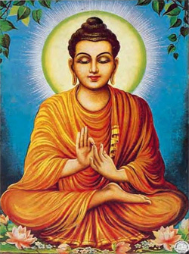
When a person becomes a Buddhist they promise to follow the 5 moral precepts.
What does moral precept mean?
right and wrong
guidelines

Slide 5
Buddhists believe that if people kept their promises and followed the 5 moral precepts, they would be able to grow in wisdom and understanding of what is right and they would develop karuna which is compassionate love for all others.

Slide 6
You are all going to become experts in the 5 moral precepts…..
By teaching each other!
Task
In groups of 5 – take one card each. Read, make notes and answer the questions on your moral precept.
Now, taking it in turns, teach your moral precept to the other group members.
As the other group members are speaking, make sure you listen, make notes and are able to answer the questions!

Slide 7
The first precept
Questions to answer
- Why is this precept important?
Do you think that this precept would be easy to follow?
To avoid harming other living beings
That means not killing / harming
- people
- animals too (many Buddhists are vegetarian)
- and the Earth! It means not destroying the natural world around us
The positive side of this precept is:
To try to show loving kindness towards all creatures.

Slide 8
The second precept
To avoid taking what is not given
That means
- not stealing
- not trying to get more than my fair share
- not trying to grab at wealth or power or fame at the expense of others
The positive side of this precept is:
To try to be generous and willing to share.
Questions to answer
- Why is this precept important?
Do you think that this precept would be easy to follow?

Slide 9
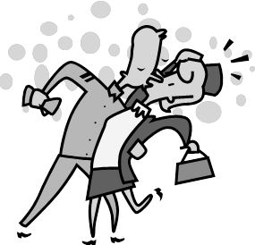
The third precept
Questions to answer
- Why is this precept important?
Do you think that this precept would be easy to follow?
To avoid being unfaithful / not cheating on a loved one
That means:
Not hurting a loved one’s feelings by being unfaithful
Not cheating
The positive side of this precept is:
To try to be faithful and happy within relationships.

Slide 10
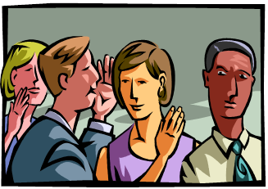
The fourth precept
Questions to answer
- Why is this precept important?
Do you think that this precept would be easy to follow?
To avoid saying what is not true
That means:
- not deliberately lying
- not trying to give the wrong impression
- not even being dishonest with yourself
The positive side of this precept is:
To try to be completely truthful- honest and open in everything I say.

Slide 11
The fifth precept
Questions to answer
- Why is this precept important?
Do you think that this precept would be easy to follow?
To avoid clouding my mind with alcohol or drugs
That means:
- not getting drunk
- not doing anything that clouds your mind and takes you over (this might include things like gambling)
The positive side of this precept is:
To try to keep my mind clear, so that I can be alert and aware of everything around me.

Slide 12
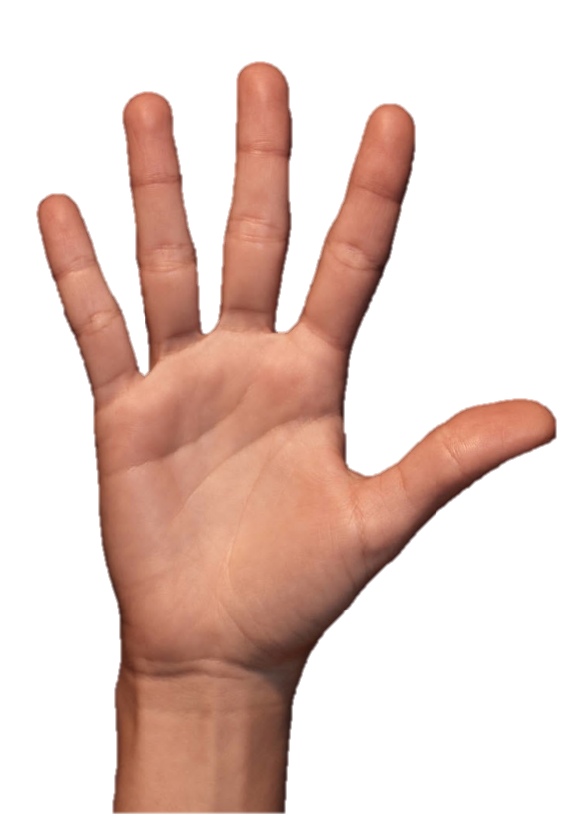
Design a poster which could be used around the school, which would inform people of what the 5 precepts are and how we could use them in our school.
Success Criteria:
1. Key words used from the key word bank.
2. Written in short sentences
5. Examples given to demonstrate understanding
Bright colours, pictures and drawings are needed to take it stand out!
Planners out.
Homework is to finish your poster and to make sure that all 5 moral precepts are illustrated on your poster.
Due in next lesson!

Slide 13
Buddhists believe that by following the 5 moral precepts you could develop Karuna
2. Buddhists think that we can help and support each other instead of doing things like taking drugs or getting drunk.
3. One of the 5 moral precepts is to take what is not given.
4. Buddhists believe that people should always try to tell each other the truth in a respectful way.
5. The 5 moral precepts is a good guide to living your life.
Stand up if its true!
Stay seated if its false!

