Slide 1
Ready for September??
An introduction to Music Technology Year 10 2020

Slide 2
I’ve picked Music Technology; what will I be doing?
In this PowerPoint I’ll give you a quick rundown of what the course looks like, some links to different websites, and some reading to get you used to the more specialist musical vocabulary we’ll be using come September
Ready??

Slide 3
How is the course made up?
This course is made up of 4 units
These will be taught over the two years
ALL need to be completed in order to pass the course
All are marked by us AND an external examiner

Slide 4
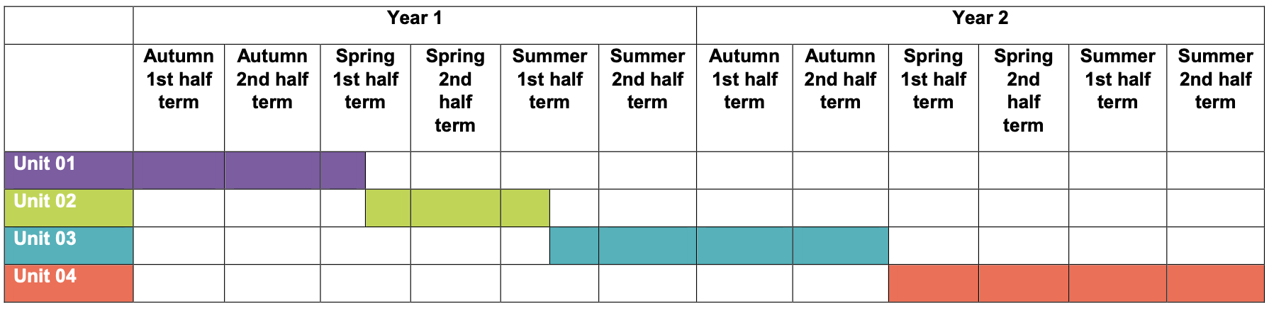
Course Overview
This is how the course will be delivered over the two years
Each unit is broken down into Learning Outcomes

Slide 5
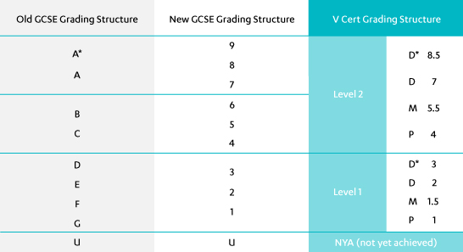
How is it marked?
You will produce an internally assessed and externally quality assured portfolio of evidence
You will complete a 4 hour externally set and assessed question paper and practical assessment.

Slide 6
Music Technology Links
https://www.bbc.co.uk/teach/class-clips-video/music-ks3-gcse-introduction-with-dev/zmyygwx
https://www.youtube.com/channel/UCcQBdibdDxH2ngu3kNPYOEA
https://musictechstudent.co.uk/music-technology/introduction-sound-basics/
https://www.soundonsound.com/
https://www.youtube.com/watch?v=TXZpCZX8S3Q
https://www.youtube.com/watch?v=ab_TBVZewoQ

Slide 7
Reading
Music Tech Guide – this pdf document will give you a really clear overview of the work we will be doing next year, and the key vocabulary you will need to learn. It’s in the folder and is called ‘NCFE Music Tech Full Revision Guide’
https://www.open.edu/openlearn/science-maths-technology/engineering-and-technology/technology/sound-music-technology-introduction/content-section-1.1

Slide 8
Wow!!!! I’m going to learn all that???
Yes you are!
And if you’re reading this and haven’t put Music Technology down as an option for next year, let us know as soon as you can!!

Slide 9



Have a great summer!!!

